Slide 1

Modifying the trajectory of a drone following a reconfiguration of the airspace
Supervised by : Mr Daniel ZAPATA
Bastien GERMAN, Chouaib LAAOUINA, Guohao DAI, Maha DRISSI-EL BOUZAIDI, Mohammed-Amine JAAFARI, Othmane CHAOUCHAOU

Slide 2
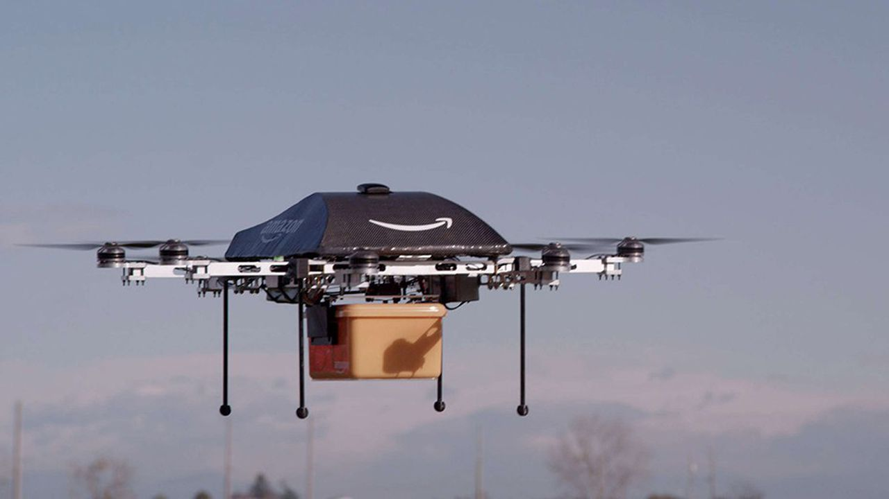

Context of the project
Increase in the use of drones :
surveillance
mapping
data collection
delivery…
Any regulations ?
yes, for civilians
unclear for large number of drones
or for automated / out of sight drones

Slide 3




A need for new regulations : U-Space project

Slide 4
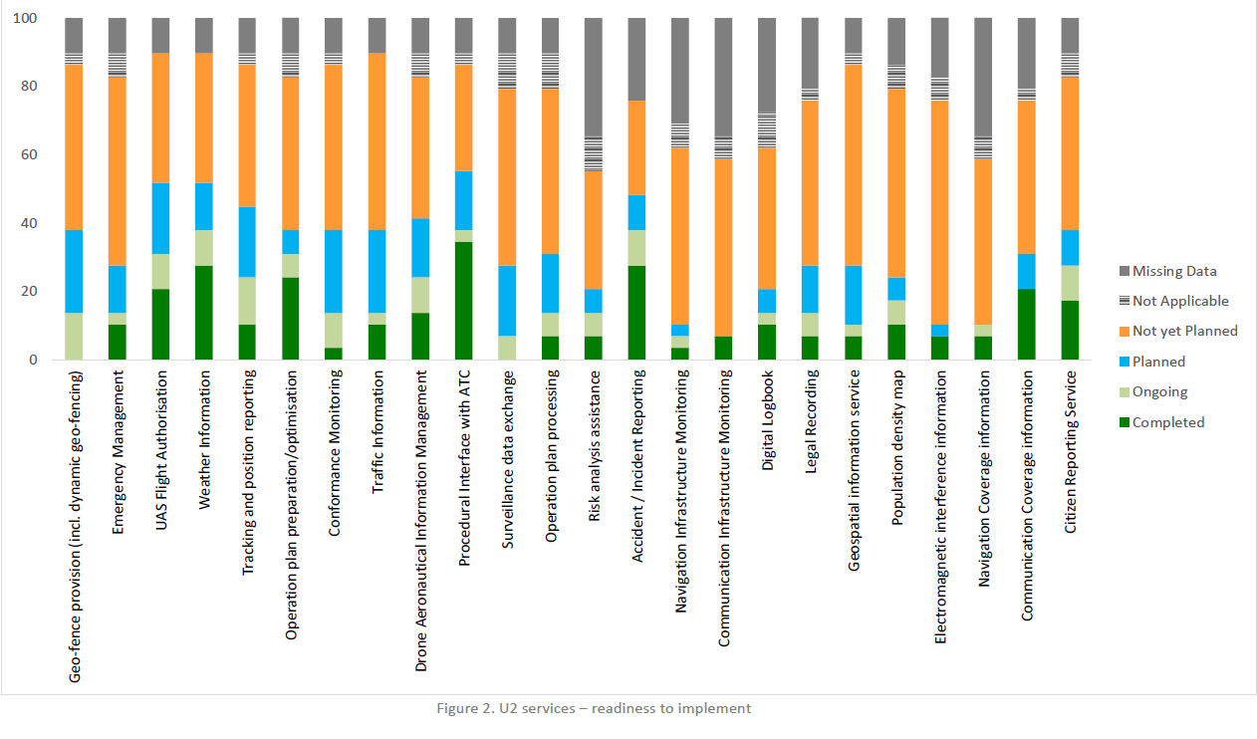
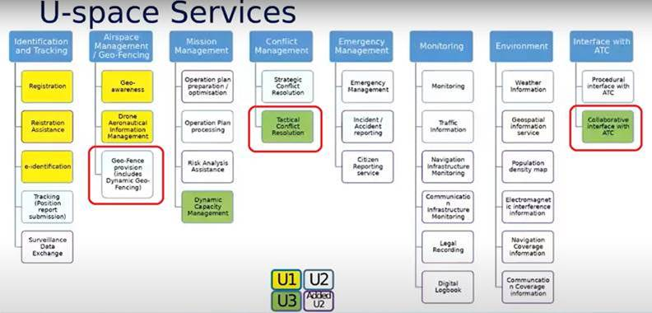
The U-Space services
Graph of the readiness of U2 services
Chart of the U-Space services

Slide 5
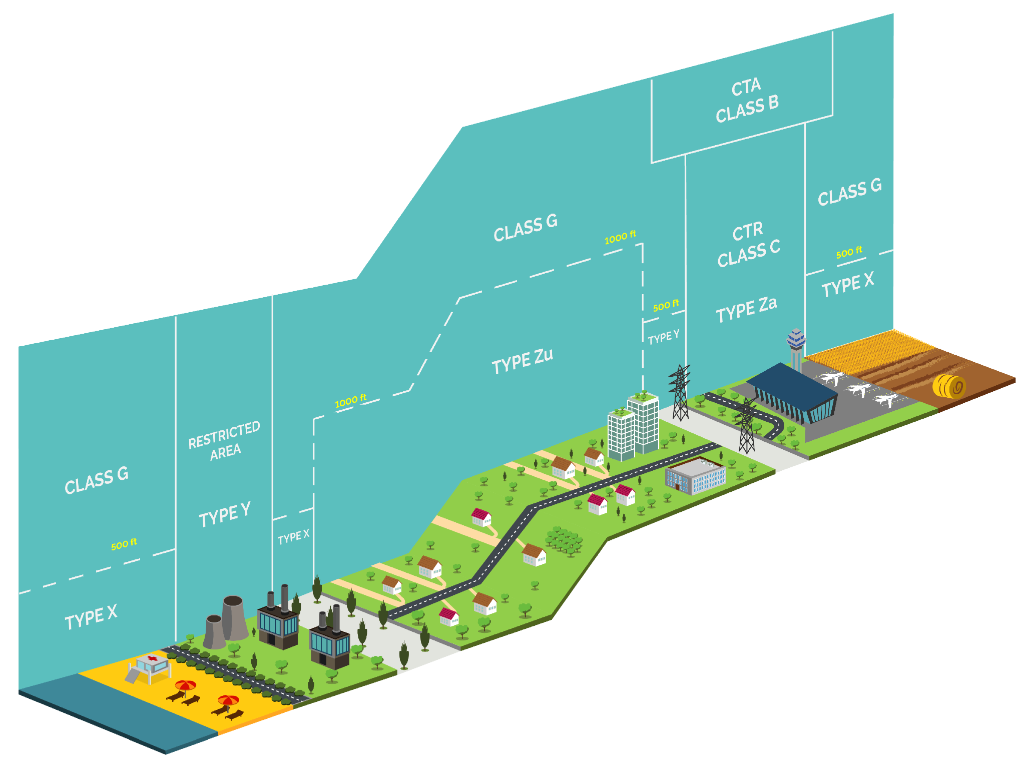
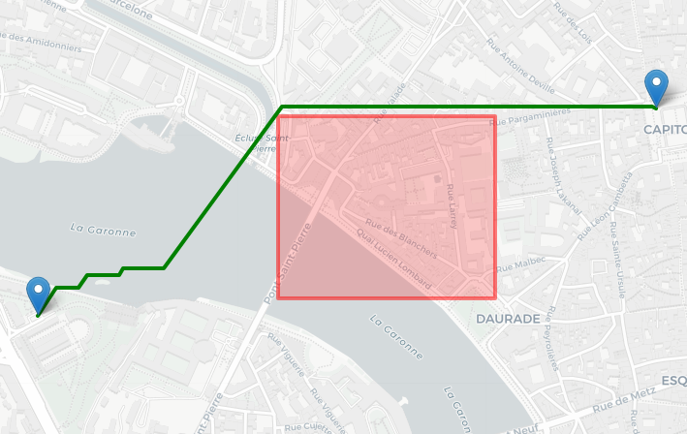
Objectives and scope
Trajectory modification
Geofencing

Slide 6
Plan
1 - Introduction
2 - Work Organization and task planning
3 - Development Tools and versioning
4 - Algorithm
5 - Demonstration
6 - Conclusion

Slide 7
Work Organization and Task Planning

Slide 8
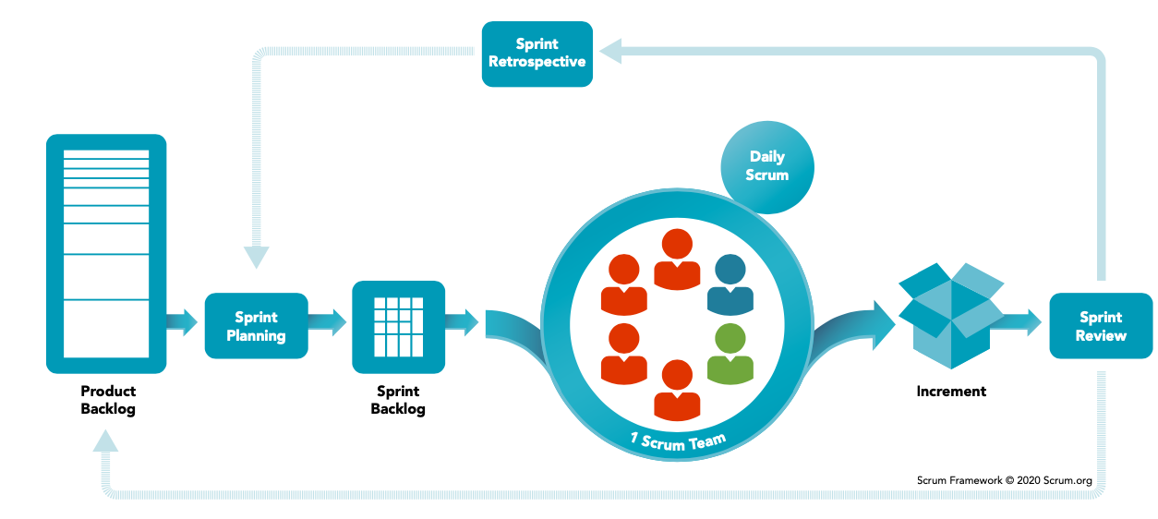
Development Cycle : Agile methodology (Scrum)

Slide 9

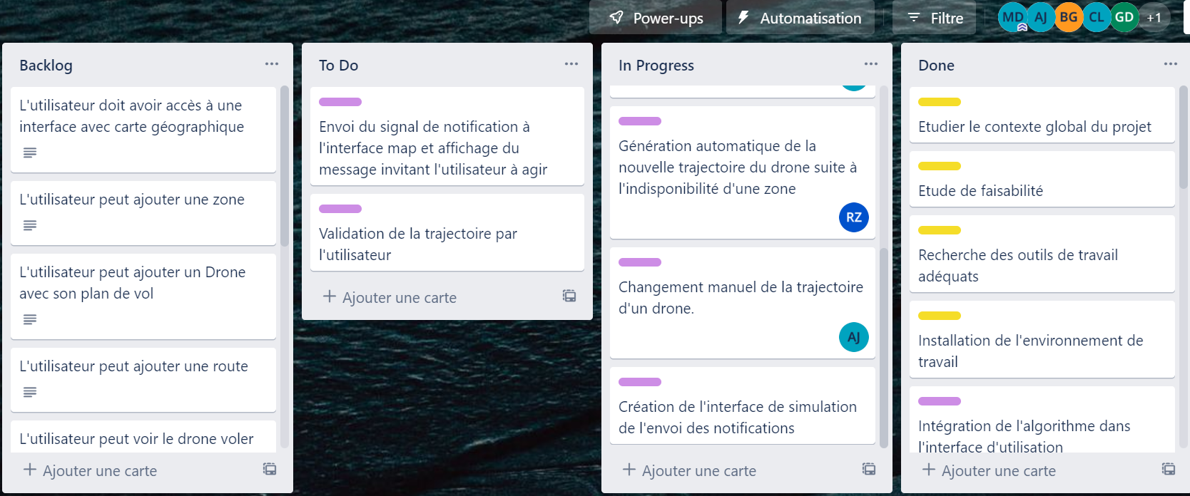
Development cycle

Slide 10
Parallelized Tasks
Development of basic interface
Path Manual Modification
Airspace Configuration and flight plans
Tasks
Development of trajectory modification algorithm
External Simulation Module

Slide 11
Development Tools

Slide 12

Main development Language
– Simple
– Versatile
– Ease of development

Slide 13

GUI
PyQt was used as a framework for the GUI ,since
the development was used with Python,PyQt was the
optimal answer as it is a Python GUI library
that creates rich and interactive interfaces for python
applications .

Slide 14

API used to display interactive maps
Leaflet.js offers an easy to use
and interact with maps,it’s also very
lightweight and fast,plus it has
great synergy with Qt channel ,which enables us to visualize geospatial data
in PyQt applications .

Slide 15

Versioning
– Track and manage changes to our codebase .
–Three main branches:
• Master branch which holds the official release
history and the release tag that identifies the different releases.
• Dev branch contains all new features being developed and merged.
• Feat branch which spawns feature branches following a naming convention : feat/featureName.

Slide 16
Path Finding Algorithm

Slide 17
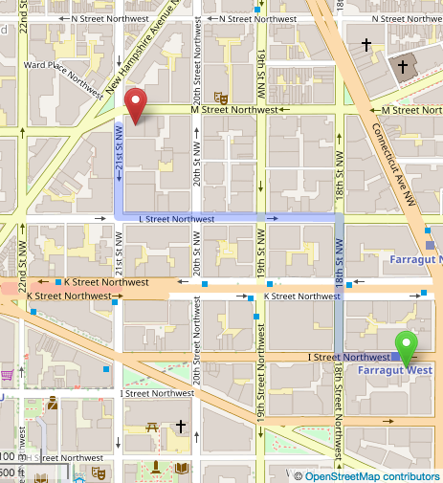
What is the A* Algorithm ?
A* is an extended BFS algorithm that finds the shortest path from a point A to a point B in a graph.
A* is optimal.(gives the best solution).
A* is complete(finds all the possible solutions).

Slide 18
How does the A* work?
It uses a heuristic function to estimate the cost of reaching the target node for example euclidean distance.
The algorithm maintains a priority queue to explore neighboring nodes in order of their estimated cost.
It avoids exploring already explored nodes and updates the priority of nodes with lower estimated cost.
The A* algorithm maintains a closure set to keep track of nodes that have already been explored and ensures that each node is explored only once.

Slide 19
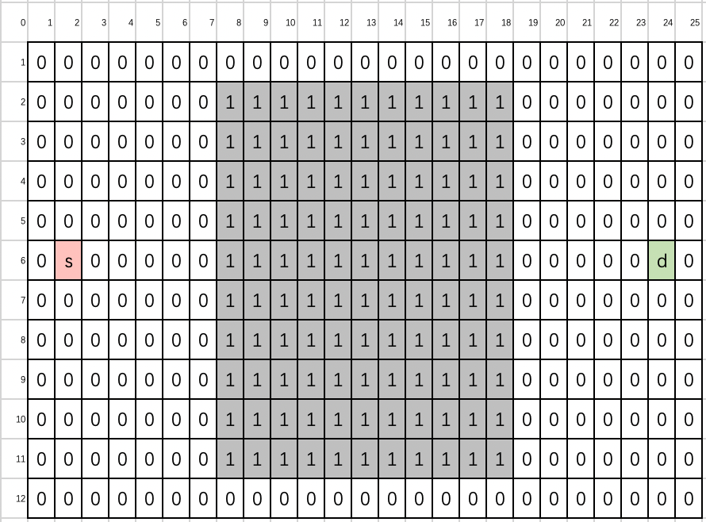
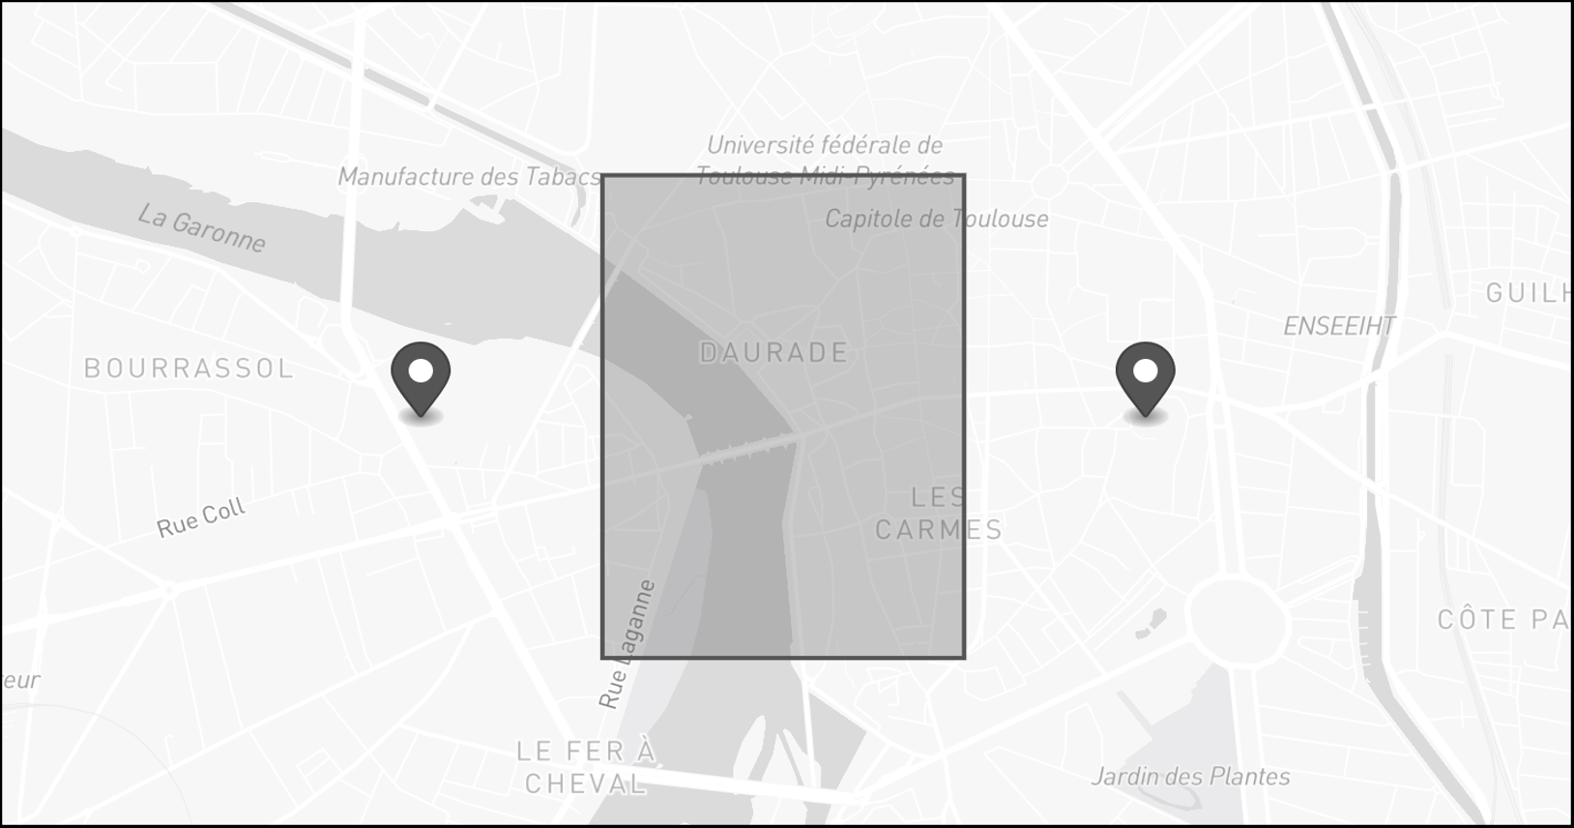
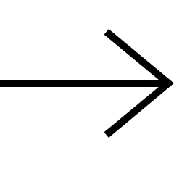
Implementation of A* algorithm in a grid

Slide 20
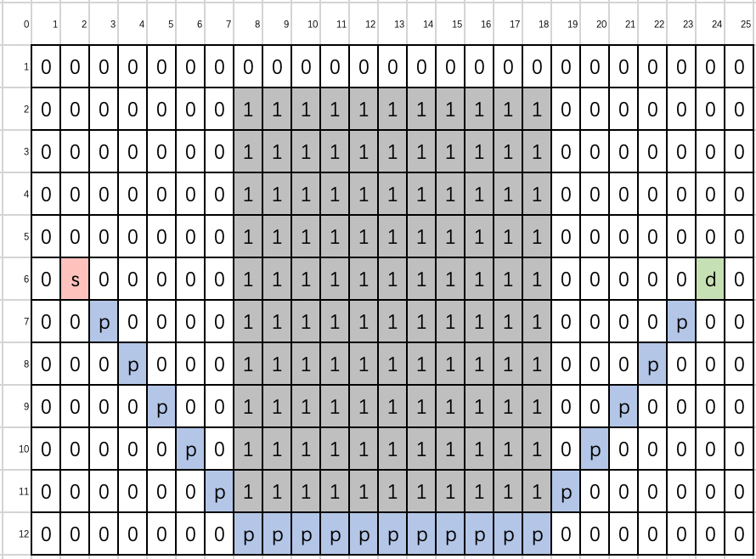
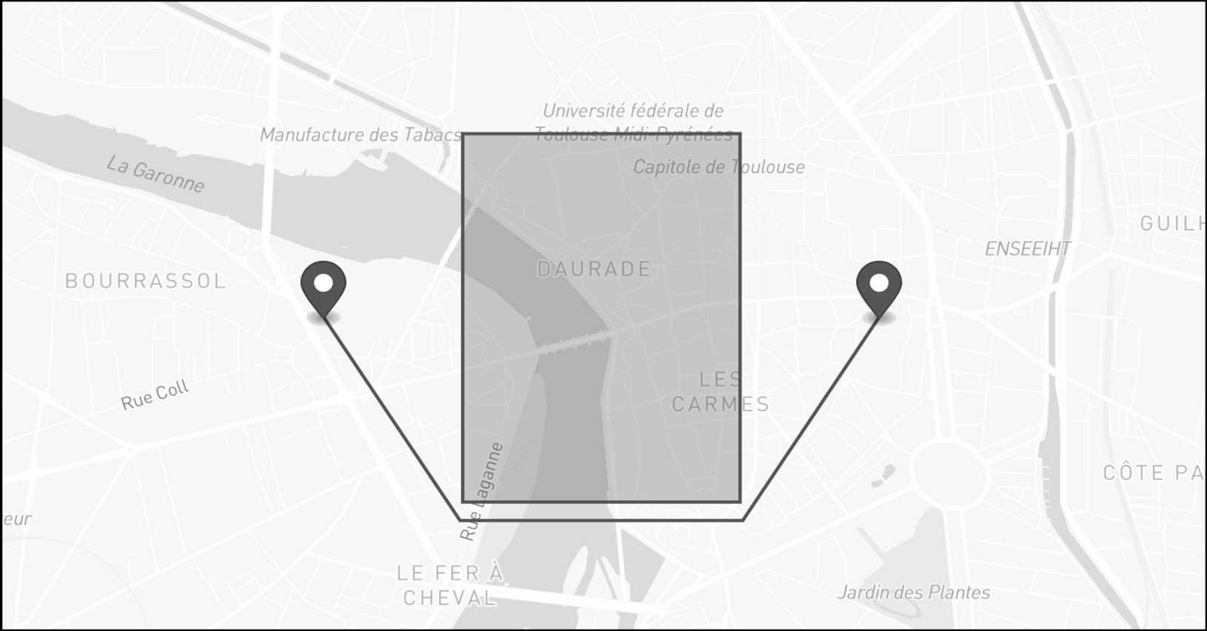
Visualization of the grid and the A* algorithm

Slide 21
Complexity
Metric | Complexity
Time | O(b^d)
Space | O(n)
Where:
b: branching factor (maximum number of successors for any node)
d: depth of the shortest path from start node to goal node
n: number of nodes explored in the search

Slide 22
Demonstration

Slide 23
Conclusion

Slide 24
Overall..
A functional GUI
Create drones’ paths
Create obstacles
Simulate and control drones’ flight in real time
Modify drones’ flight plan mid-flight

Slide 25
Future prospects
Integration of a notification system
Upgrading to a 3D map
Simulation of multiple drones
Notes:
-to warn users of changes in the airspace
-noticable difference between altitudes

Slide 26
Soft skills
Communication
Collaboration and conflict resolution
Time management
Flexibility

Slide 27
Thank you for your attention!

